Slide 1
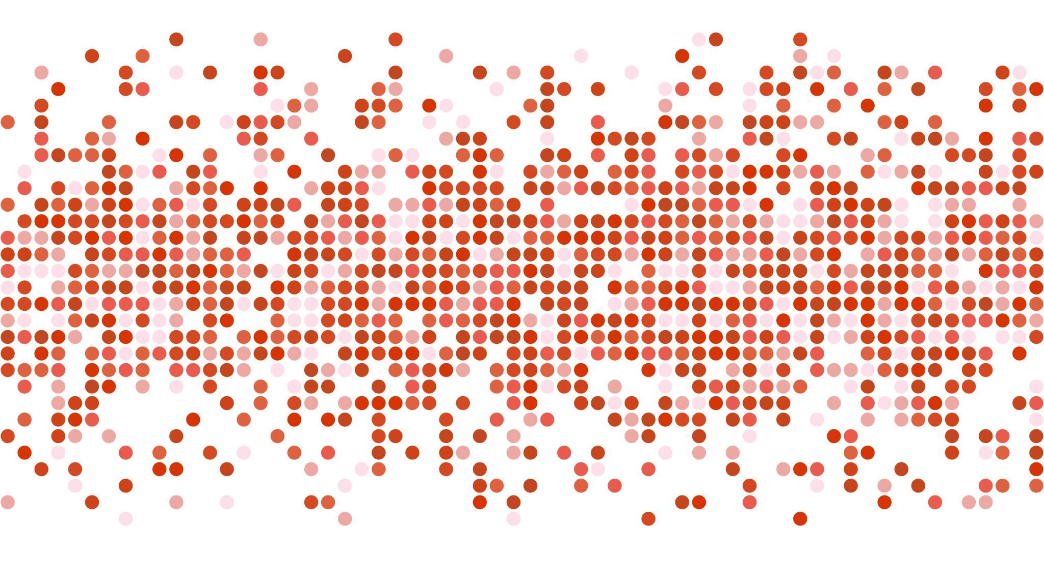
ANTICIPATING MENSTRUAL MIGRAINE USING DEEP LEARNING
Jain deemed-to-be University
Department of Computer Science and Engineering
Final Year Project
TEAM – 12
Pranav Polavarapu – 19BTRCR008
Sushil Bokade - 19BTRCR017
Sai Keerthi Chelluri – 19BTRCR036
Sai Sharanya Y – 19BTRCR043
Guide:
Prof. Mohammed Zabeeulla A N

Slide 2

OBJECTIVES
This project aims to build an ANN Model that identifies, classifies, and anticipates an occurrence of Menstrual Migraine in women. This is based on the severity of symptoms that a woman experiences – like throbbing, periods, Nausea, visual disturbances, intensity, & many more.
An GUI(Graphical User Interface) is built using Python modules & Integrated Interface for easy application access.

Slide 3

ABSTRACT
Menstrual Migraines are headaches that occur without any typical aura or sensory disturbances. They can be labeled as 'Migraine without Aura'. A woman could undergo menstrual migraine just before or during her period starts. This is majorly due to the drop in estrogen levels in the body. Menstrual migraines can be intense, & they must be identified accurately & treated separately from regular ones. Anticipating Menstrual Migraines using Deep Learning methodology can help women in taking precautions beforehand and aid in improving their health.

Slide 4

LITERATURE REVIEW

Slide 5
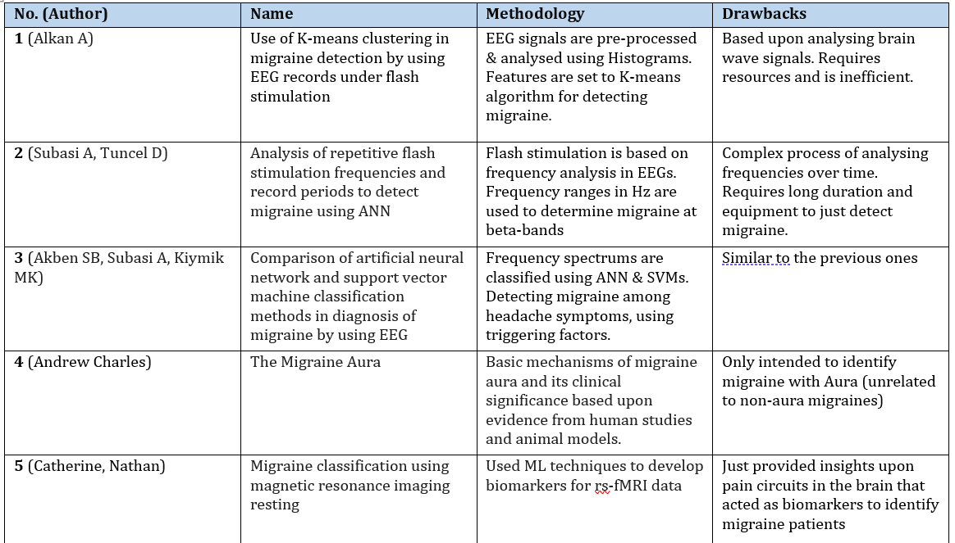

Slide 6
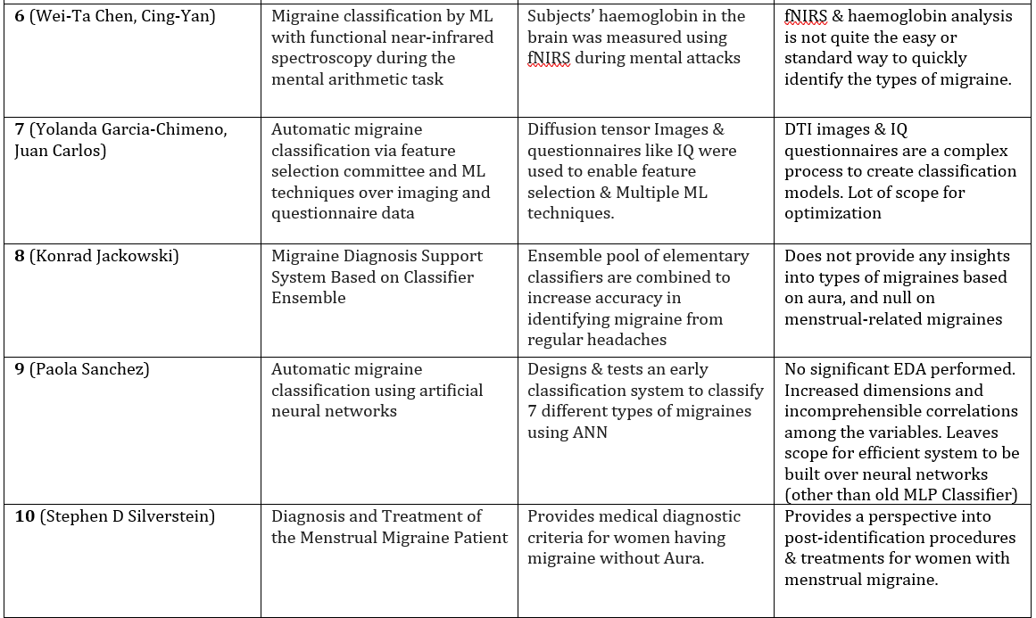
[ Existing System – Base Paper]

Slide 7
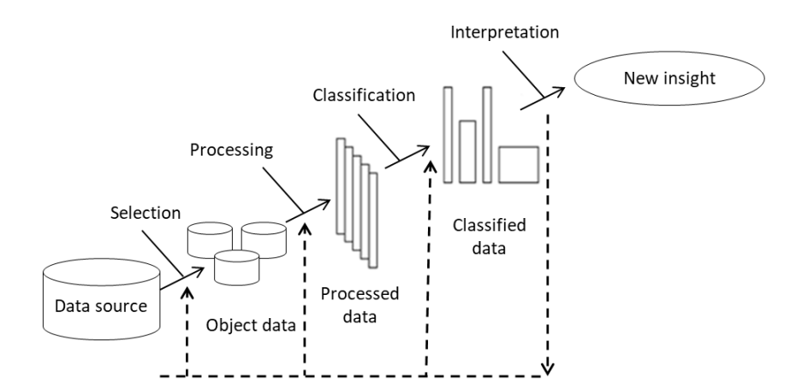
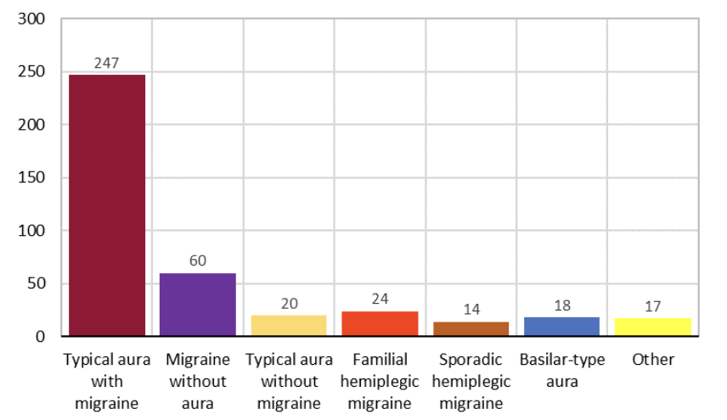
Existing System
This paper tested different approaches to classify general migraine types and confirm that ANN is the best model as it provides here high accuracy.

Slide 8
PROPOSED SYSTEM
Data Collection (Public Health Repos/Physicians/Women surveys)
Secured Storage in supportable formats (Repository ensuring Privacy)
Scaling & Encoding All symptom severity values
Thorough EDA is performed
Statistical tools & Visualizations in Python
Significant Feature Identification & Feature Engineering
Necessary Libraries are imported for Deep Learning Support
Neural Network Model is initiated
Correct input & neuron values are given
Activation functions & solvers are chosen properly
Model comparsions & Hyperparameter tuning
Cross-Validation
Embedding into a period tracking web interface or User Interface

Slide 9
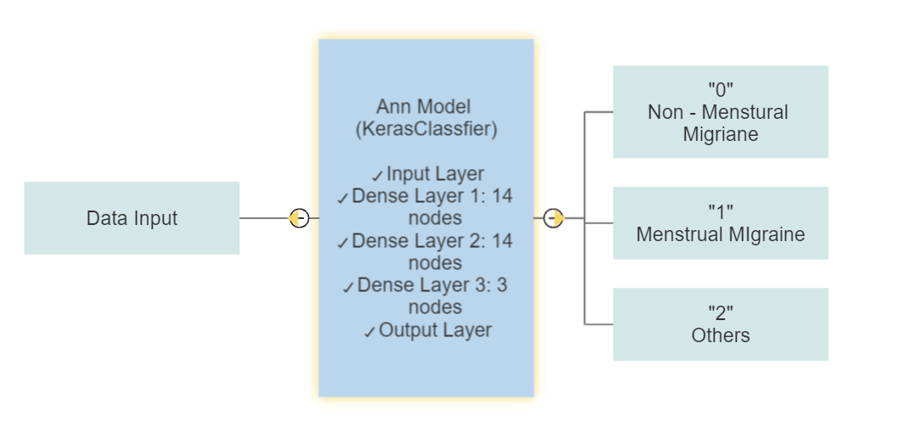
Overall Schematic Diagram of the Project.

Slide 10
METHODOLOGY
We propose an efficient methodology to accurately classify the headaches into 3 major types. Our primary focus would be on identifying menstrual migraines from regular migraines so that one can anticipate its occurrence for prior treatment properly.
Data shall be collected from public health repositories, physicians, and women who are experiencing a variety of symptoms relating to headaches or migraines. This data is pre-processed and maintained neatly in a comprehensible format.
The data is comprised of numerous quantifiable and simple but important symptoms that a woman would experience. Ex – Nausea, Visual aura, Intensity level, Frequency, Period status, etc.
All the symptoms and severities are scaled and encoded into simpler values for efficient processing by the models.
Data undergoes thorough Exploratory Analysis to identify correlations, impacts and insignificances of the variables present at hand. This is done in a visual manner for better understanding of the data.
Finally, the important features are identified, and they are ready to be fed into a Deep Learning- based Neural network Classifier.

Slide 11
The classifier system is built using Neural Networks for categorizing multiple classes effectively. Each layer is added in a sequential format, with the correct parameters relating to the shape of the input & output data.
Right activations and loss functions are chosen for productive multi-class classification.
Final set of model and its hyperparameters are tuned using methods like cross validation.
GUI application is created and model is embedded into it in order to provide easy access.

Slide 12
Work done so for
Clear Problem Statement definition
Thorough review of multiple related papers was done & Base paper was identified.
Collected medically-valid data from a public health repository that comprises numerous significant symptoms for migraines.
Designed a methodology architecture for implementing the system
Symptom severities - Scaled, Encoded, Simplified through preprocessing
Comprehensive EDA performed using statistical visualizations & comparing correlations of variables
Model building is done using ANN.
Built & Deployed User Interface which runs on top of the Model in the backend

Slide 13
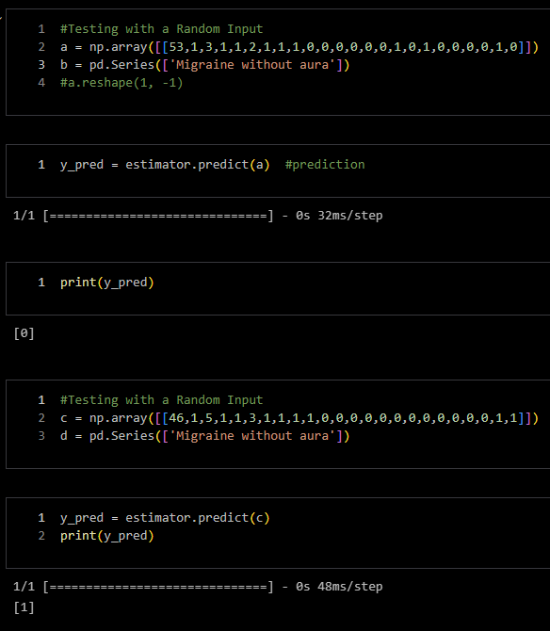
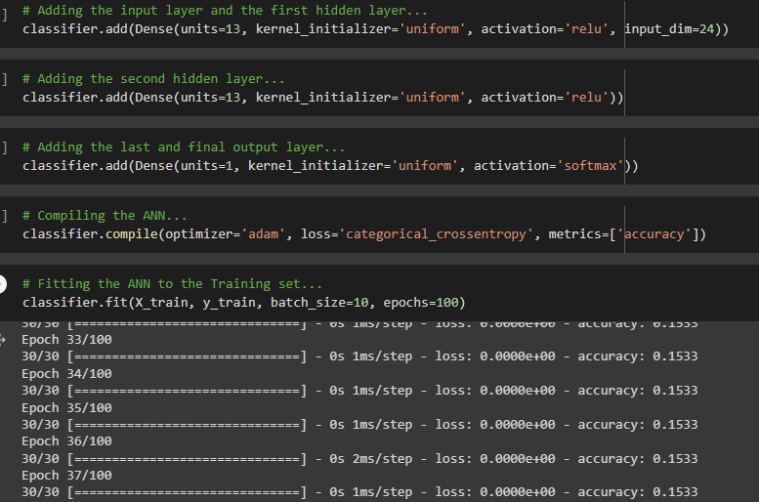
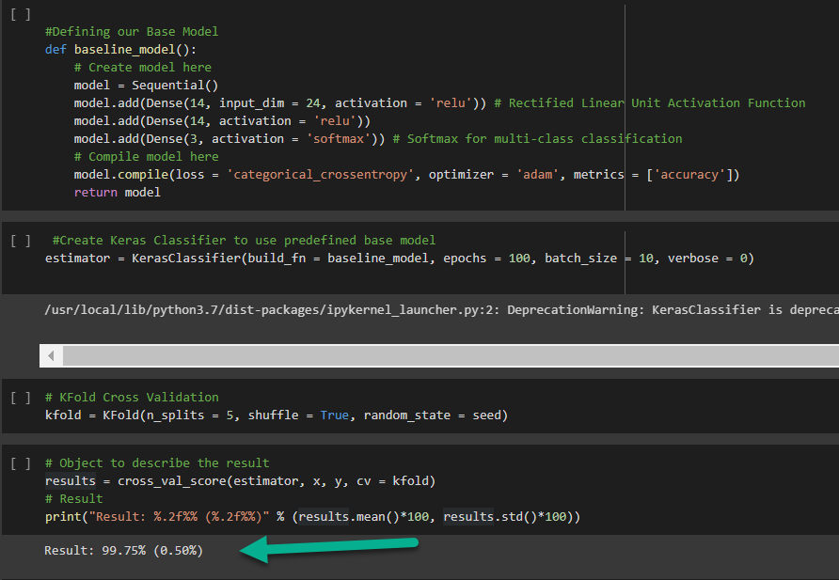
EXPERIMENTAL RESULTS

Slide 14
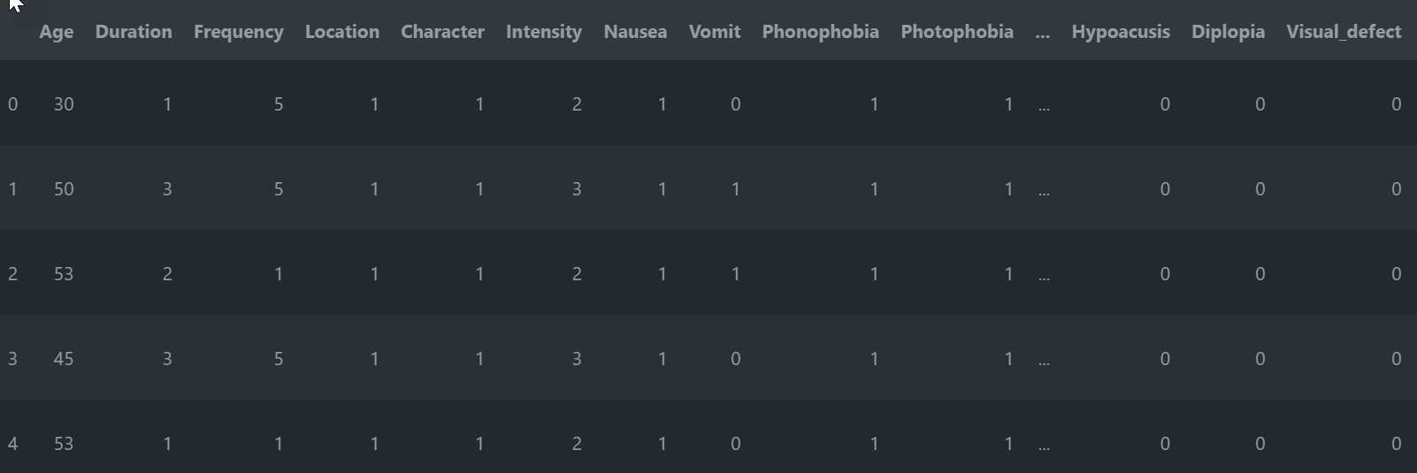
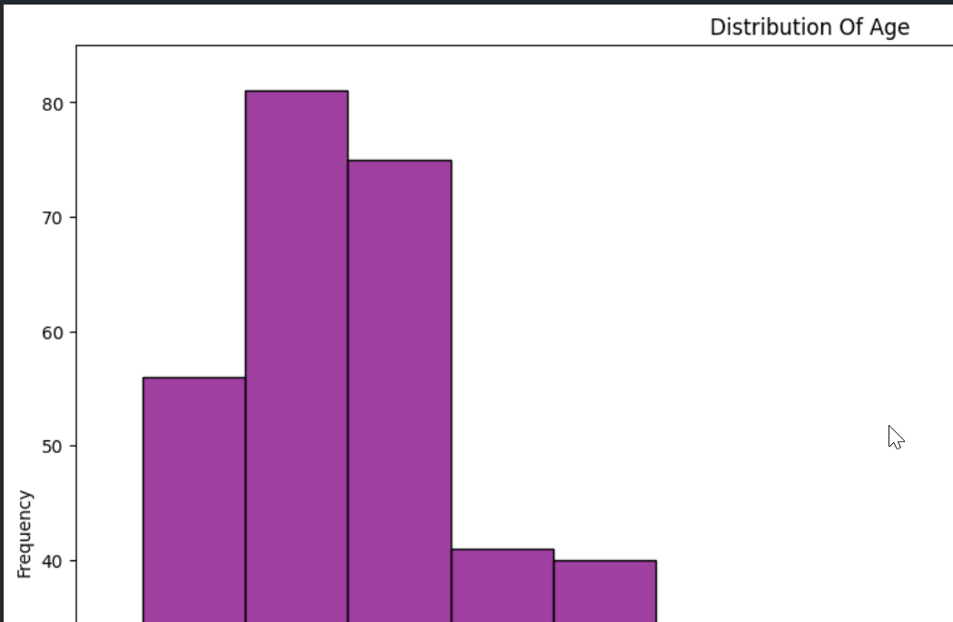
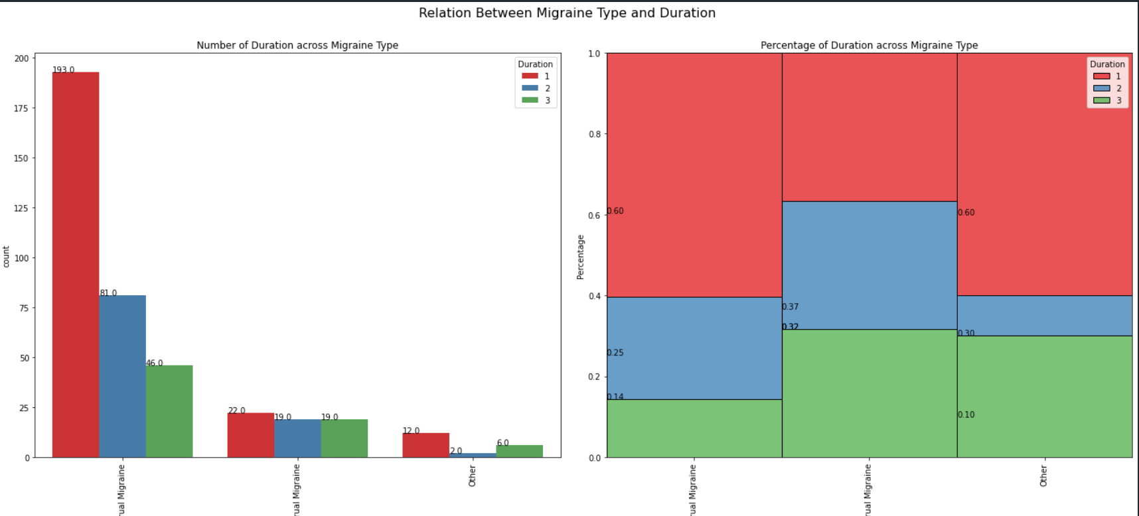
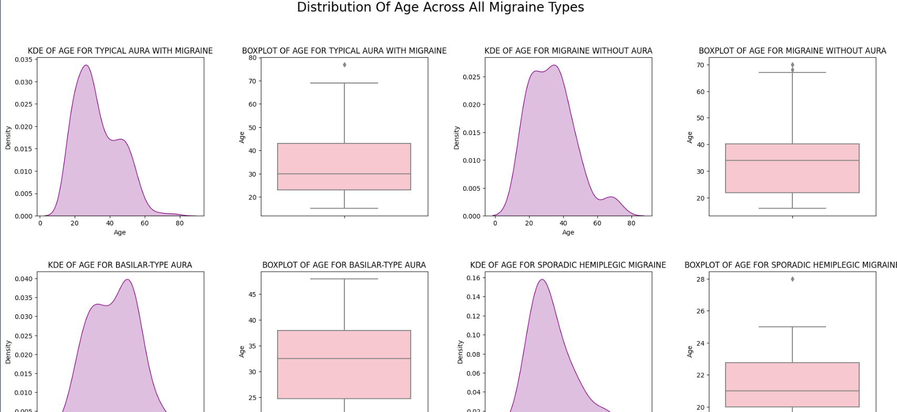

Slide 15
Deploying the Model on a Web Interface.
Choosing a Web Interface framework
Developing required pages
- Building Model & UI Pages/Elements
Embed the Model
We’ll be choosing Gradio Application here
Loading the trained ANN model.

Slide 16
Deploying the Model on a Web Interface.
Accept inputs
Designing a web form that allows the user to input relevant data.
Preprocess inputs
Converting the data to correct format and normalizing values as needed.
Make predictions
Using the Deep Learning Model to make predictions based on the processed User inputs

Slide 17
Giving the Model a Web Interface.
Return Appropriate Results
Save Results in the database.
Returning the mapped results to the user through a web Interface.
Saving the inputs and results to a database.
FeedBack
Constantly Feed the new Data from the DB, back into the Model, to improve the accuracy

Slide 18
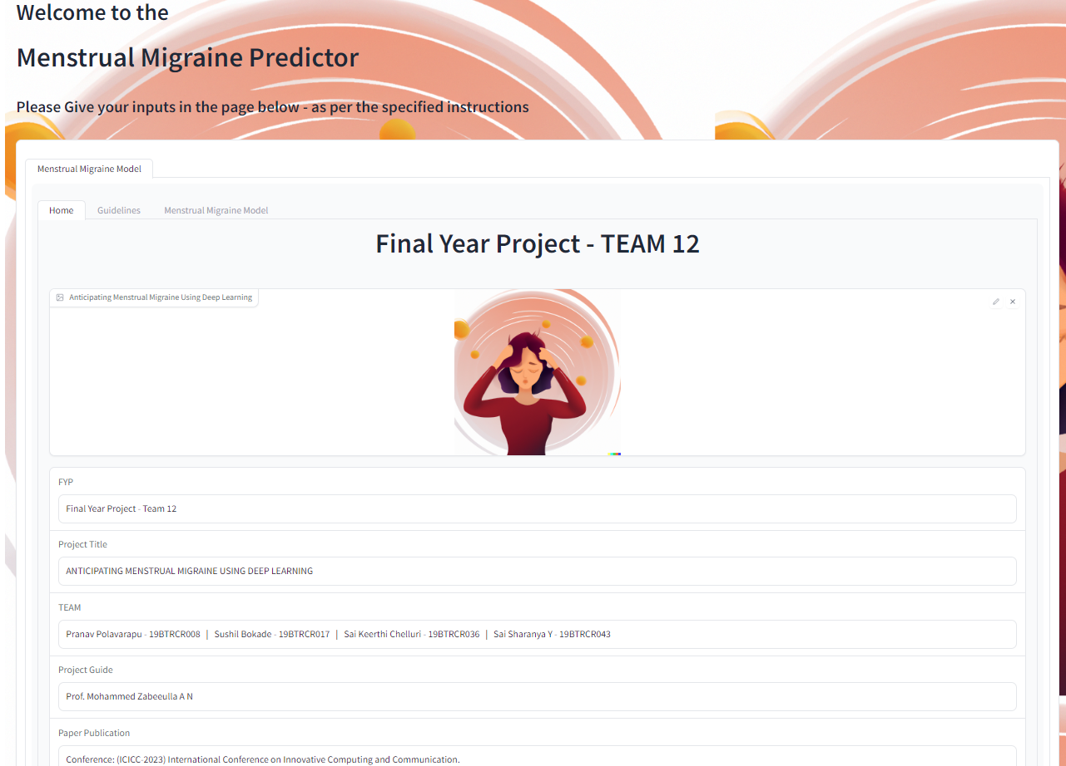
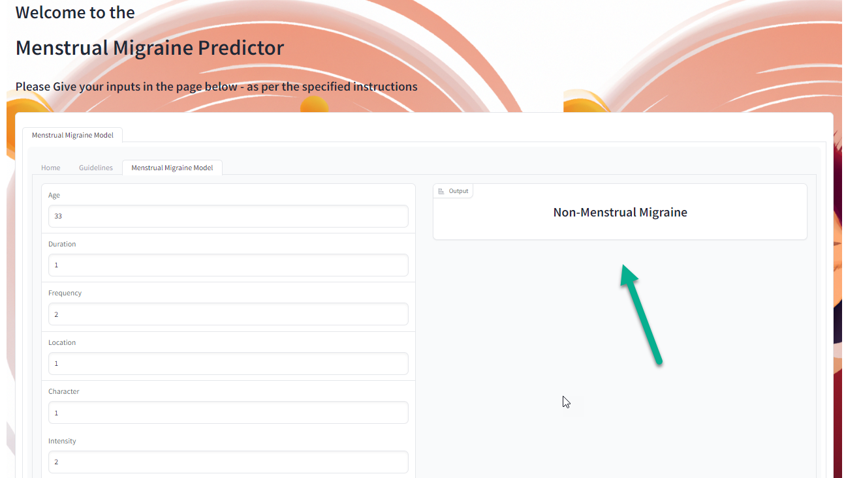
Model User Interface

Slide 19
Software and Hardware Requirements.
Hardware Requirements:
Processor: 8th Gen i5
Ram: 8GB
64-bit Operating System
x64 – based processor
Software Requirements:
NumPy
Pandas
Seaborn
Matplotlib
Sci-kit learn
Python 3.10
IDE

Slide 20
Paper Publication.
Conference: (ICICC-2023) International Conference on Innovative Computing and Communication.
Organized by: Shaheed Sukhdev College of Business Studies in collaboration with Springer and the University of Delhi.
Conference Dates: 17th -18th February 2023.
Publication Status: Paper Submitted/Accepted.

Slide 21
REFERENCES
Ahmet, Alkan, and Batuhan Akben Selahaddin. "Use of k-means clustering in migraine detection by using EEG records under flash stimulation." International Journal of Physical Sciences 6, no. 4 (2011): 641-650.
Akben, Selahaddin Batuhan, Abdulhamit Subasi, and Deniz Tuncel. "Analysis of repetitive flash stimulation frequencies and record periods to detect migraine using artificial neural network." Journal of medical systems 36, no. 2 (2012): 925-931.
Akben, Selahaddin Batuhan, Abdülhamit Subaşı, and Mahmut Kemal Kıymık. "Comparison of artificial neural network and support vector machine classification methods in diagnosis of migraine by using EEG." In 2010 IEEE 18th Signal Processing and Communications Applications Conference, pp. 637-640. IEEE, 2010.
Charles, Andrew. "The migraine aura." Continuum: Lifelong Learning in Neurology 24, no. 4 (2018): 1009-1022.
Chong, Catherine D., Nathan Gaw, Yinlin Fu, Jing Li, Teresa Wu, and Todd J. Schwedt. "Migraine classification using magnetic resonance imaging resting-state functional connectivity data." Cephalalgia 37, no. 9 (2017): 828-844.
Ang, Kai Keng, Cuntai Guan, Kerry Lee, Jie Qi Lee, Shoko Nioka, and Britton Chance. "A brain-computer interface for mental arithmetic task from single-trial near-infrared spectroscopy brain signals." In 2010 20th International Conference on Pattern Recognition, pp. 3764-3767. IEEE, 2010.
Garcia-Chimeno, Yolanda, Begonya Garcia-Zapirain, Marian Gomez-Beldarrain, Begonya Fernandez-Ruanova, and Juan Carlos Garcia-Monco. "Automatic migraine classification via feature selection committee and machine learning techniques over imaging and questionnaire data." BMC medical informatics and decision making 17, no. 1 (2017): 1-10.
Jackowski, Konrad, Dariusz Jankowski, Dragan Simić, and Svetlana Simić. "Migraine diagnosis support system based on classifier ensemble." In International conference on ICT innovations, pp. 329-339. Springer, Cham, 2014.
Sanchez-Sanchez, Paola A., José Rafael García-González, and Juan Manuel Rúa Ascar. "Automatic migraine classification using artificial neural networks." F1000Research 9 (2020).
Silberstein, Stephen D., and Susan L. Hutchinson. "Diagnosis and treatment of the menstrual migraine patient." Headache: The Journal of Head and Face Pain 48 (2008): S115-S123.

Slide 22


